Slide 1
CSS 534 Final Project
Hongbin Li

Slide 2
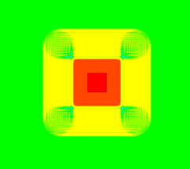
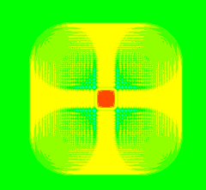
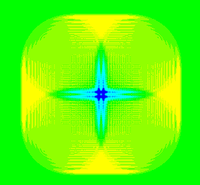
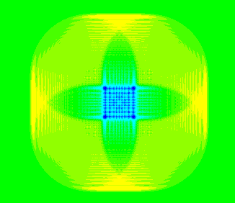
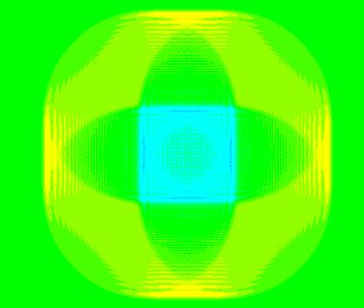
Wave2D Simulation
Current wave[2], pre wave[1], pre-pre wave[0]
Use wave[1] (north, east, south, west) and wave[0] to calculate wave[2]
Update wave[0] with wave[1], update wave[1] with wave[2]
Start the next iteration

Slide 3
Code with openMP & MPI
if(my_rank % 2 == 0){
//send first, and then receive
if(my_rank == 0){
if(mpi_size > 1){
MPI_Send(z1 + (stripe-1)*N, N, MPI_DOUBLE, 1, 0, MPI_COMM_WORLD);
MPI_Recv(z1 + stripe*N, N, MPI_DOUBLE, 1, 0, MPI_COMM_WORLD, &r_status);
}
}else{
MPI_Send(z1+N, N, MPI_DOUBLE, my_rank-1, 0, MPI_COMM_WORLD);
if(my_rank != mpi_size-1)
MPI_Send(z1+stripe*N, N, MPI_DOUBLE, my_rank+1, 0, MPI_COMM_WORLD);
MPI_Recv(z1, N, MPI_DOUBLE, my_rank-1, 0, MPI_COMM_WORLD, &r_status);
if(my_rank != mpi_size-1)
MPI_Recv(z1+(stripe+1)*N, N, MPI_DOUBLE, my_rank+1, 0, MPI_COMM_WORLD, &r_status);
}
}else{
MPI_Recv(z1, N, MPI_DOUBLE, my_rank-1, 0, MPI_COMM_WORLD, &r_status);
if(my_rank != mpi_size-1)
MPI_Recv(z1+(stripe+1)*N, N, MPI_DOUBLE, my_rank+1, 0, MPI_COMM_WORLD, &r_status);
MPI_Send(z1+N, N, MPI_DOUBLE, my_rank-1, 0, MPI_COMM_WORLD);
if(my_rank != mpi_size-1)
MPI_Send(z1+stripe*N, N, MPI_DOUBLE, my_rank+1, 0, MPI_COMM_WORLD);
}
for (i = 1; i < i_end; i++) {
for (j = 1; j < N - 1; j++) {
z2[i*N + j] = 2.0 * z1[i*N + j]
- z0[i*N+j] + c * c * dt * dt / (dd*dd)
* (z1[(i+1)*N + j] + z1[(i-1)*N + j]
+ z1[i*N+j+1] + z1[i*N+j-1] - 4.0 * z1[i*N+j]);
}
}

Slide 4
Code with MASS
void *Wave2DMass::exchangeWave( void *argument ) {
double *retVal = new double;
//*retVal = *(double *)((time == 0) ? &wave[0] : &wave[1]);
*retVal = (time == 0) ? wave[0] : wave[1];
return retVal;
}
wave[2] = 2.0 * wave[1] - wave[0] +
c * c * dt * dt / ( dd * dd ) *
( neighbors[north] + neighbors[east] + neighbors[south] +
neighbors[west] - 4.0 * wave[1] ); //wave two based on wave[1] and wave[0]
wave[0] = wave[1]; wave[1] = wave[2]; //shift wave[] measurements, prepare for a new wave[2]
for ( int time = 0; time < maxTime; time++ ) {
wave2d->callAll( Wave2DMass::computeWave_, (void *)&time, sizeof(int) );
wave2d->exchangeAll( 1, Wave2DMass::exchangeWave_, &neighbors );
}

Slide 5
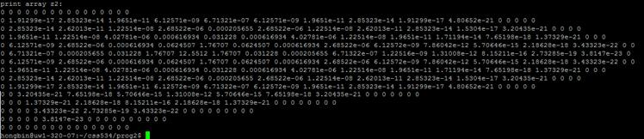
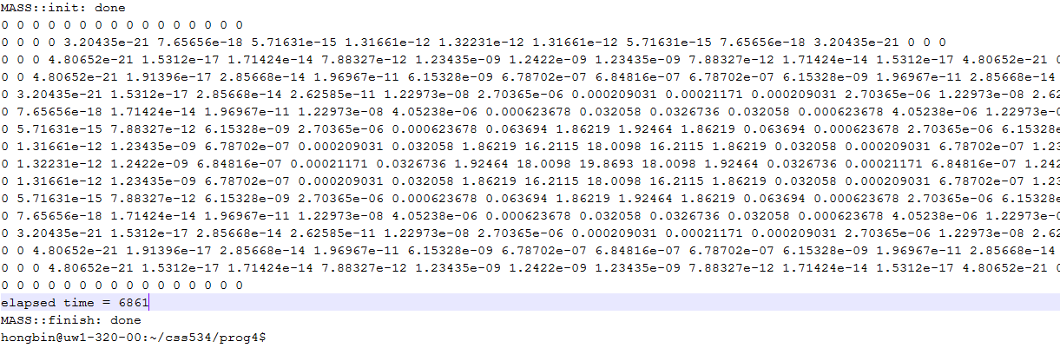
Execution

Slide 6
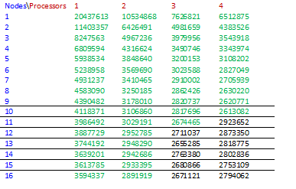

Performance
openMP, MPI
MASS

Slide 7
Programmability
openMP & MPI | MASS
Absolute index | Relative index
Manually split data | Automatically split data
MPI_Send/Recv | exchangeAll, put data in inMessages
Hard debug | Easy to debug
Tedious detail, slow development | Quick development
Big view, flexible for agent to interact with many places | Not flexible for agent interact with place

